Slide 1
Binary Search Tree (BST) Data Structure
Dr. Naveen Kumar
Associate Professor
Amity Institute of Information Technology
Amity University Patna

Slide 2
Binary Tree
Recursive definition
An empty tree is a binary tree
A node with two child subtrees is a binary tree
Only what you get from 1 by a finite number of applications of 2 is a binary tree.

Slide 3
BST
A Binary Search Tree (BST) is a special type of binary tree that maintains its elements in a sorted order.
It is a non-linear, hierarchical data structure, where each node can have at most two children, and elements are organized in a parent-child relationship.
For every node in the BST:
Left Child key < node’s key and
Right Child key > node’s key (>= if duplicates are allowed)

Slide 4
dynamic set operations.
Search, Minimum, Maximum, Predecessor, Successor, Insert, and Delete.
Can be used to build
Dictionaries.
Priority Queues.
Basic operations take time proportional to the height of the tree – O(h).

Slide 5
BST Representation
Represented by a linked data structure of nodes.
root(T) points to the root of tree T.
Each node contains fields:
key
left – pointer to left child: root of left subtree.
right – pointer to right child : root of right subtree.
p – pointer to parent. p[root[T]] = NIL (optional).

Slide 6
nodes in the left subtree contain values strictly less than the node’s value.
nodes in the right subtree contain values strictly greater than the node’s value.
Efficient operations for searching, insertion, and deletion of elements, especially when the tree remains balanced.
Widely used in database indexing, symbol tables, range queries, and are foundational for advanced structures like AVL tree and Red-Black tree.
Operations ie search, insertion, and deletion takes O(Log n) time for a balanced binary search tree. In the worst-case (unbalanced), these degrade to O(n).
With self-balancing BSTs like AVL and Red Black Trees, we can ensure the worst case as O(Log n).

Slide 7
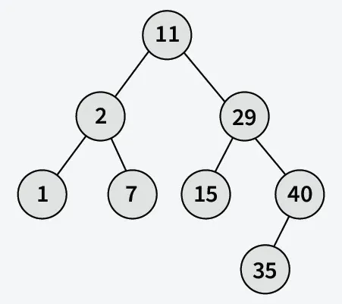

Slide 8
Advantages BST
Efficient searching: O(log n) time complexity for searching with a self balancing BST
Ordered structure: Elements are stored in sorted order, making it easy to find the next or previous element
Dynamic insertion and deletion: Elements can be added or removed efficiently
Balanced structure: Balanced BSTs maintain a logarithmic height, ensuring efficient operations
Doubly Ended Priority Queue: In BSTs, we can maintain both maximum and minimum efficiently

Slide 9
Limitations of BST
Not self-balancing: Unbalanced BSTs can lead to poor performance
Worst-case time complexity: In the worst case, BSTs can have a linear time complexity for searching and insertion
Memory overhead: BSTs require additional memory to store pointers to child nodes
Not suitable for large datasets: BSTs can become inefficient for very large datasets
Limited functionality: BSTs only support searching, insertion, and deletion operations

Slide 10
Binary Search Tree Property
Stored keys must satisfy the binary search tree property.
∀ y in left subtree of x, then key[y] ≤ key[x].
∀ y in right subtree of x, then key[y] ≥ key[x].
56
26
200
18
28
190
213
12
24
27

Slide 11
Operations in BST
Search : Finds whether a given key exists in the BST. Time Complexity on average is O(log n) and worst case is O(n)
Insertion : Insert a new node while maintaining BST property. Compare key with current node and move left/right recursively or iteratively. Time Complexity on average is O(log n) and worst case is O(n)
Deletion : Remove a node while keeping BST valid. Node has no children means remove directly. Node has one child means replace node with its child. Node has two children means replace node with inorder successor/predecessor and delete that successor/predecessor. Time Complexity: average O(logn) and O(n) worst case
Traversals : The four common tree traversals are Inorder (Left, Root, Right) which gives nodes in sorted order for a BST, Preorder (Root, Left, Right), Postorder (Left, Right, Root), and Level-order, which traverses the tree level by level using a queue.

Slide 12
Inorder Traversal
The binary-search-tree property allows the keys of a binary search tree to be printed, in (monotonically increasing) order, recursively.
Inorder-Tree-Walk (x)
1. if x ≠ NIL
2. then Inorder-Tree-Walk(left[p])
3. print key[x]
4. Inorder-Tree-Walk(right[p])
56
26
200
18
28
190
213
12
24
27
How long does the walk take?
Can you prove its correctness?

Slide 13
Querying a Binary Search Tree
All dynamic-set search operations can be supported in O(h) time.
h = Θ(lg n) for a balanced binary tree (and for an average tree built by adding nodes in random order.)
h = Θ(n) for an unbalanced tree that resembles a linear chain of n nodes in the worst case.

Slide 14
Properties
Unique ordering of elements means duplicates are usually not allowed.
Inorder traversal of a BST gives sorted order of elements.
Average height: O(log n) (for balanced BST).
Worst case height: O(n) (when tree becomes skewed).

Slide 15
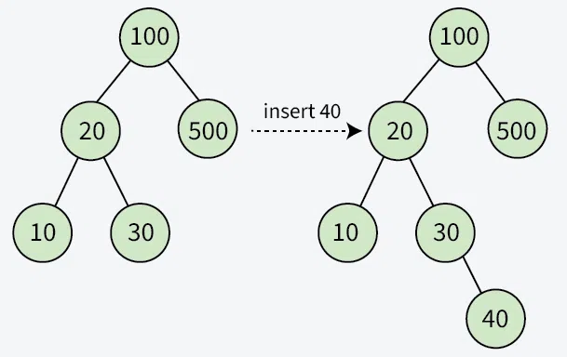
Insert Operation in BST
Given the root of a Binary Search Tree, we need to insert a new node with given value in the BST. All the nodes have distinct values in the BST and we may assume that the the new value to be inserted is not present in BST.

Slide 16
Search Operation in BST
Start at the root. Then:
Compare value to be searched with the value of the root.
If its equal search is success.
If smaller go to the left subtree.
If greater go to the right subtree.
Repeat the above step till no more traversal is possible
If at any iteration, key is found, return True. If the node is null, return False.

Slide 17
Deletion in BST
Removing the target node while ensuring that the tree remains a valid BST. There are three possible scenarios:
Case 1: Node has No Children (Leaf Node)
This is the simplest case where the node to be deleted is a leaf node (has no left or right child).
Directly remove the node from the tree by setting the corresponding child pointer of its parent to NULL.
Case 2: Node has One Child(Left or Right Child)
The node to be deleted has either a left child or a right child, but not both.
Delete the node and replace it with its child. The parent of the deleted node now points directly to the child of the deleted node.
Case 3: Node has Two Children
Little Complex…

Slide 18
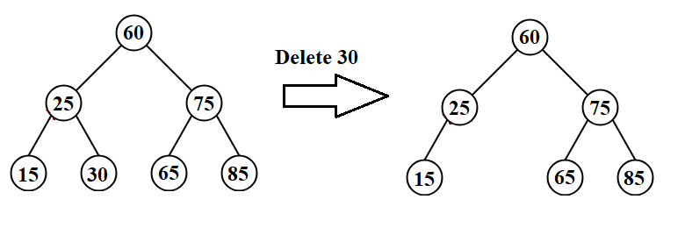

Slide 19
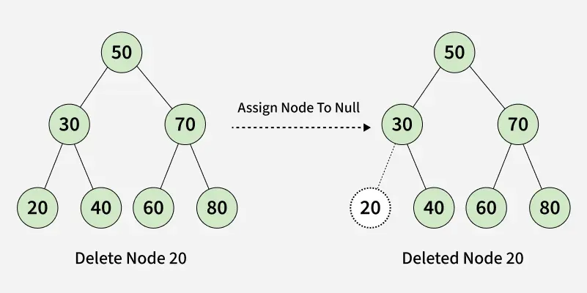
Case 1: Node has No Children (Leaf Node)

Slide 20
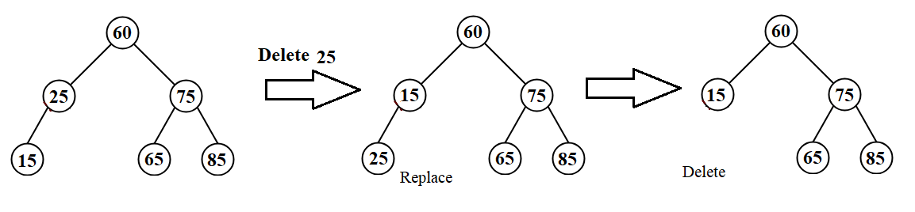

Slide 21
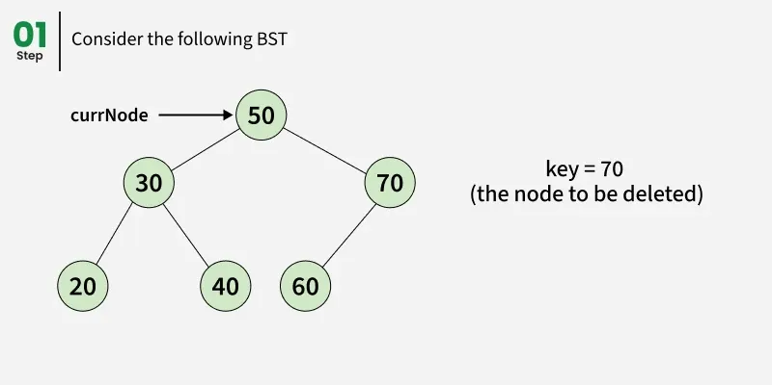
Case 2: Node has One Child(Left or Right Child)

Slide 22
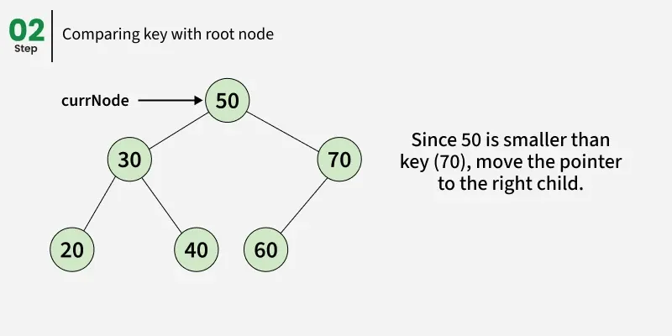
Case 2: Node has One Child(Left or Right Child)

Slide 23
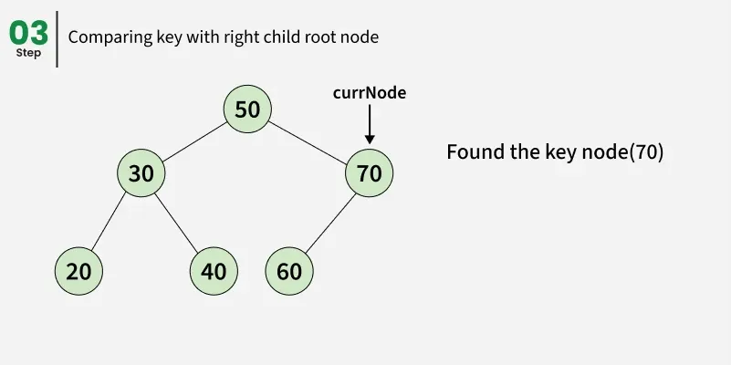
Case 2: Node has One Child(Left or Right Child)

Slide 24
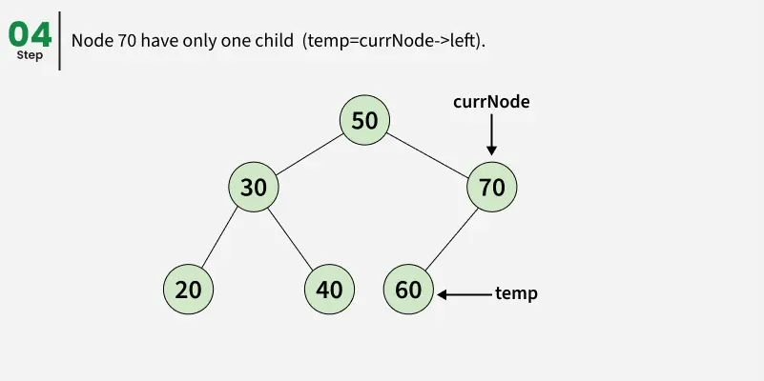
Case 2: Node has One Child(Left or Right Child)

Slide 25
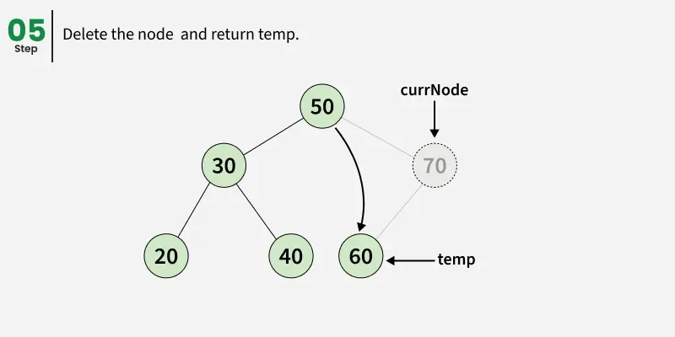
Case 2: Node has One Child(Left or Right Child)

Slide 26
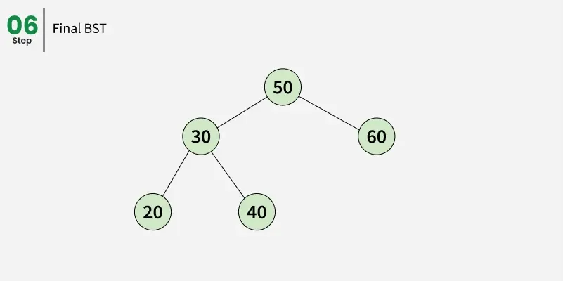
Case 2: Node has One Child(Left or Right Child)

Slide 27
Case 3: Node has Two Children
Find the node's inorder successor (smallest value in the right subtree) or inorder predecessor (largest value in the left subtree).
Copy the value of the inorder successor/predecessor to the node to be deleted.
Delete the inorder successor/predecessor node (which will now fall under case 1 or case 2).

Slide 28
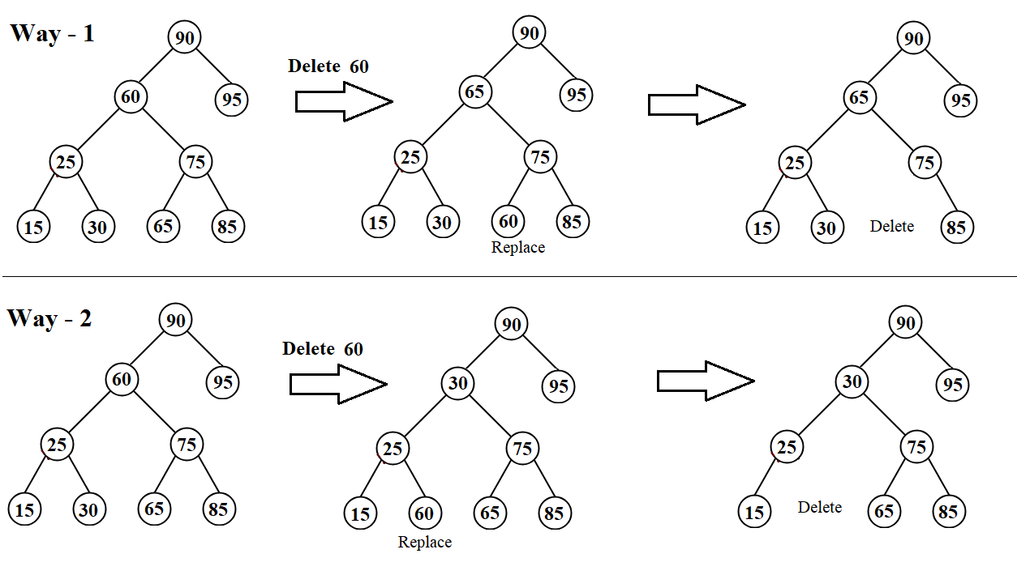

Slide 29
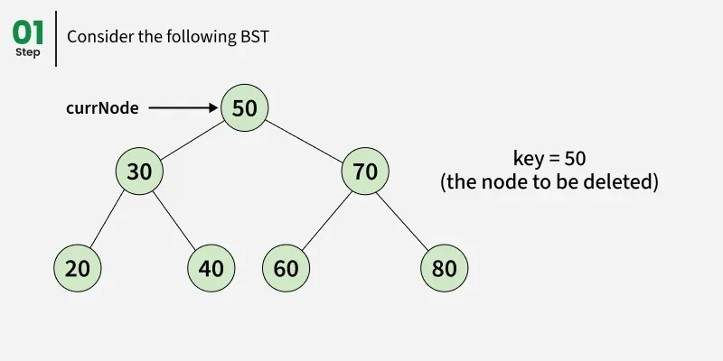
Case 3: Node has Two Children

Slide 30
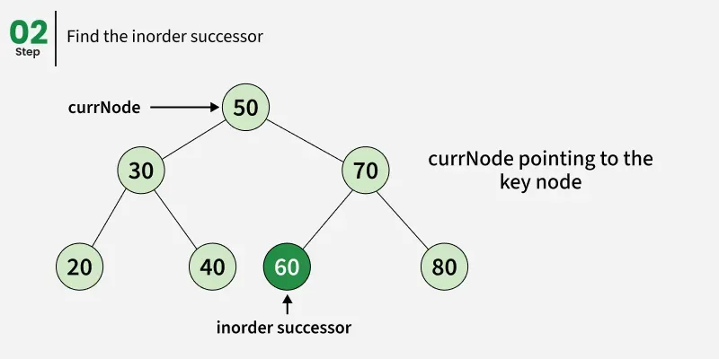
Case 3: Node has Two Children

Slide 31
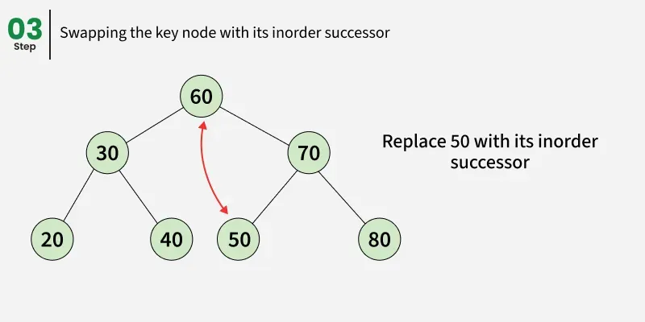
Case 3: Node has Two Children

Slide 32
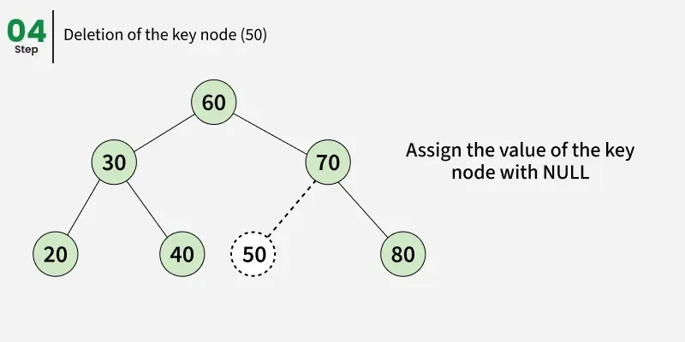
Case 3: Node has Two Children

Slide 33
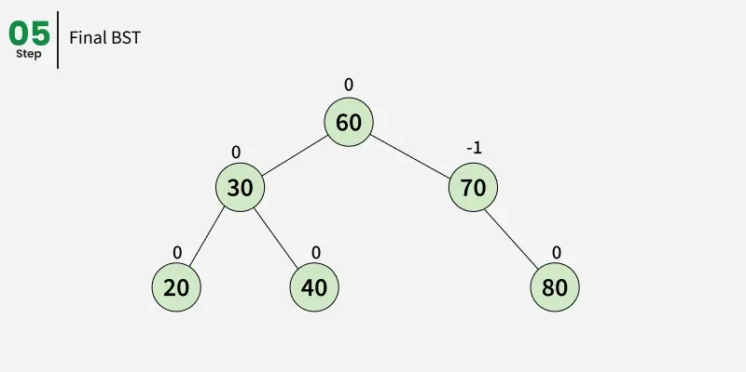
Case 3: Node has Two Children

Slide 34
BST Analysis
Time Complexity: O(h), where h is the height of the tree. In the worst case (a skewed tree), this is O(n), but it is O(logn) for a balanced tree.
Space Complexity: O(h) for the recursion stack, which can be O(n) in the worst case.
BST Property: The key to all deletions is ensuring the left subtree remains smaller and the right subtree remains larger than the root node.

